Slide 1
Paramedic Education
Virtual Future Heroes – December 2020
‘A paramedic works autonomously as a generalist clinician across a range of healthcare settings, usually in emergency, primary or urgent care. They may also specialise in clinical practice, education, leadership or research.’
The College of Paramedics (2019)

Slide 2
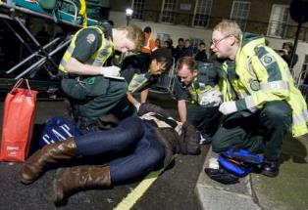
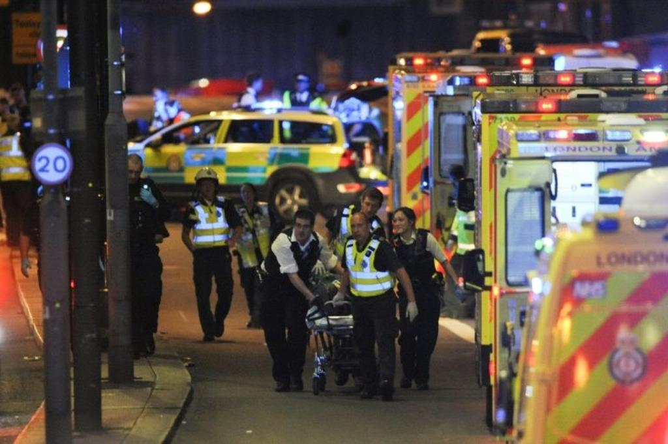
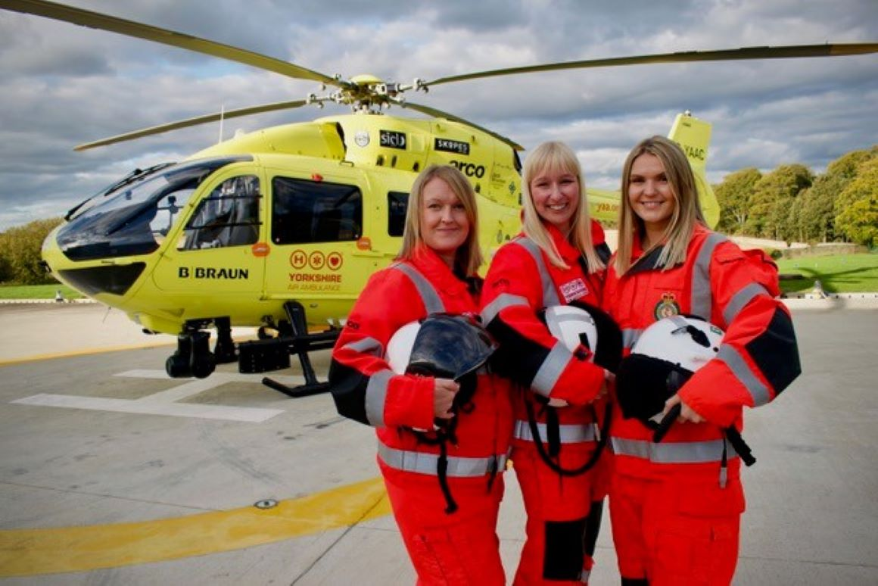
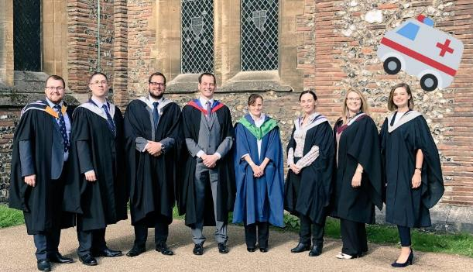
Today’s UK paramedic
#notallparamedicsweargreen

Slide 3
Why higher education for paramedics?
Paramedic
Complex decisions
High-pressure situations
Unpredictable environments
History-taking
Clinical examination
Diagnosis
Management of all injuries and illness
Research skills
On-going professional development

Slide 4
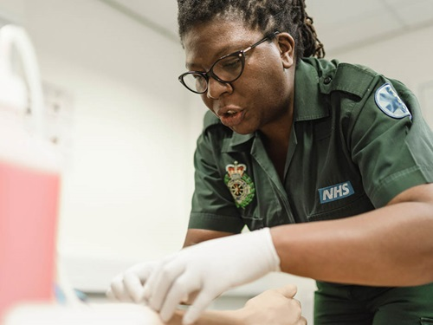
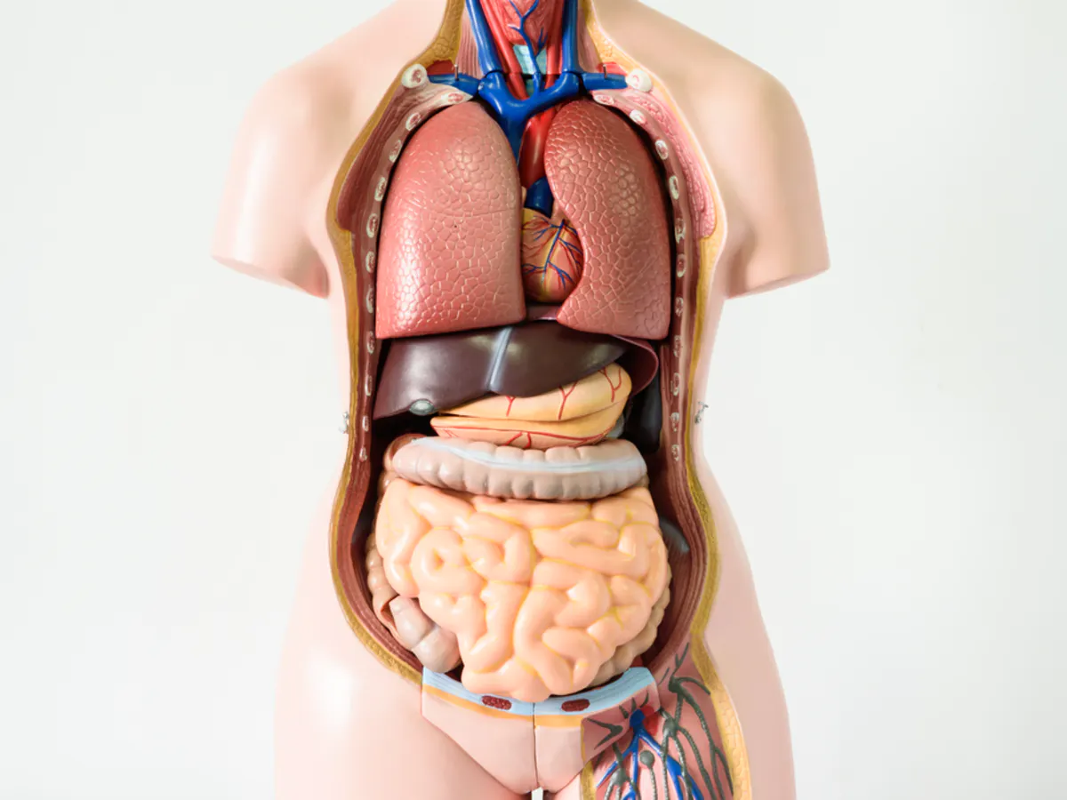
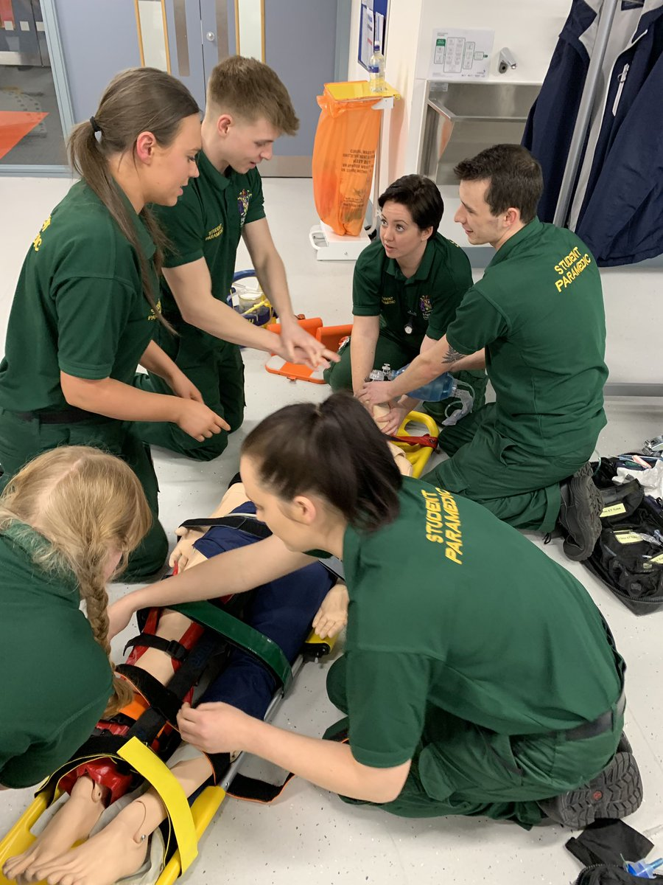
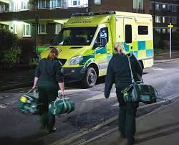
What will I study?

Slide 5
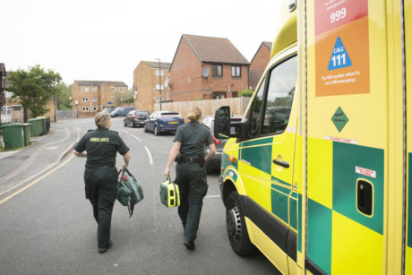
Learning in placement

Slide 6
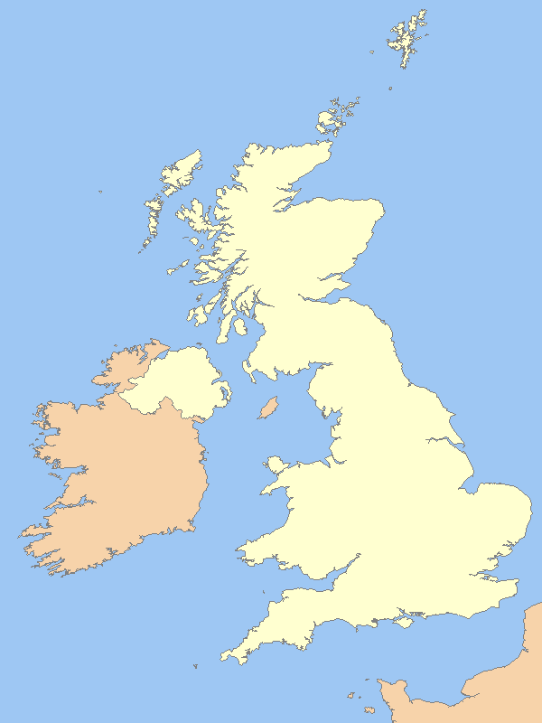
Where can I study?
48 providers across the UK
Programmes are approved by the Health and Care Professions Council (HCPC)
Placements are normally with the NHS Ambulance Service

Slide 7
Typical entry requirements
Qualifications
GSCE English and Maths (usually science too)
A-levels / BTEC / IB (or equivalent)
104-132 UCAS points – usually to include a science
Possibly a driving license
Application
Insight into profession
NHS Values
Communication
Decision-making
Leadership
Team-working
Check UCAS for specific requirements

Slide 9
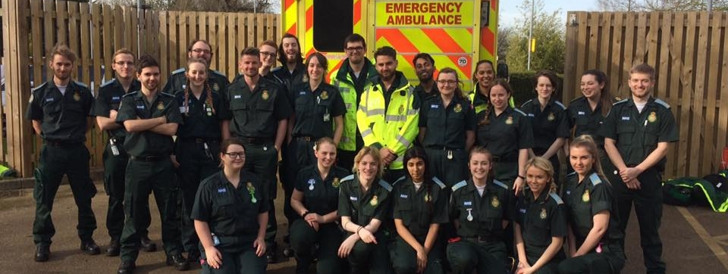
Questions?
@UHParamedic
/UHparamedic
/UHparamedic
paramedic-admissions@herts.ac.uk
www.herts.ac.uk

